Slide 1
Putin’s Energy War Against Europe

Slide 2
Group No. 6
Abdurrahman Qureshi : 210451
Oaish Qazi : 210455
Hussain Shaikh : 220486

Slide 3

What are we going to cover?
Main goal of the Russia-Ukraine war
Impact on European Economy
Side Effects of this war
Future of energy for Europe

Slide 4
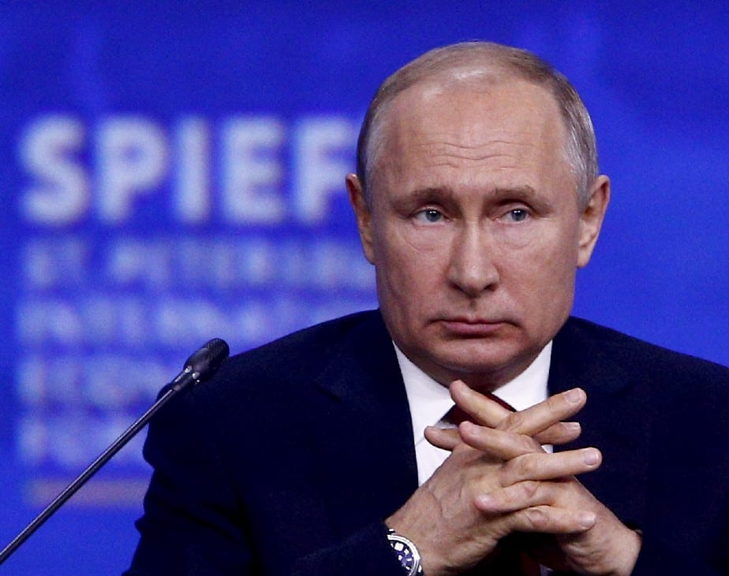
Let’s recall what happened
On 24 February 2022, Russia invaded Ukraine resulted in the Russo-Ukrainian War which officially began in 2022.
More than 8.2 million had fled the country by May 2023, becoming Europe's largest refugee crisis since World War II.
This Photo by Unknown Author is licensed under CC BY-SA-NC

Slide 5
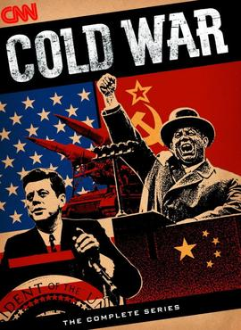
Background
After the Soviet Union (USSR) dissolved in 1991, the newly independent republics of Ukraine and Russia maintained ties.
Vladimir Putin, claimed NATO members had promised in 1990 not to let any Eastern European countries join, but this is disputed.

Slide 6

Russia’s Underlining Plan
Even though a physical war is being fought between Russia and Ukraine, a more impactful battle is being fought by common European people.
Can you guess what could it be?

Slide 7
RUSSIAN GAS

